Slide 1
Team Project
Tengyue Chen
Hao Miao
Haoxing Zhang

Slide 2
Project Introduction
Goal: Provide product recommendations based on customer purchase intentions for clothing or shopping sites
Describe: Predict consumer purchases with a dataset of consumer purchase records published on Kaggle by H&M. Models can provide companies with products that consumers are likely to buy. Therefore, online shopping platforms can provide recommendations to consumers based on the results of the model
Software: Spark
Python
PySpark

Slide 3
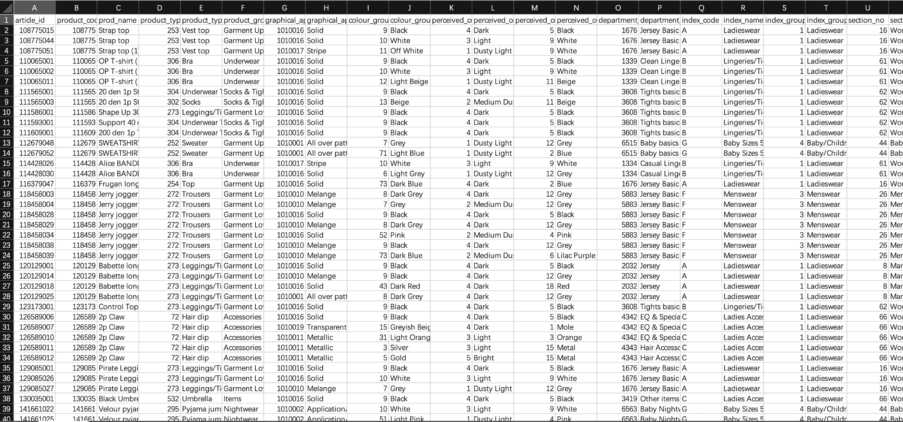
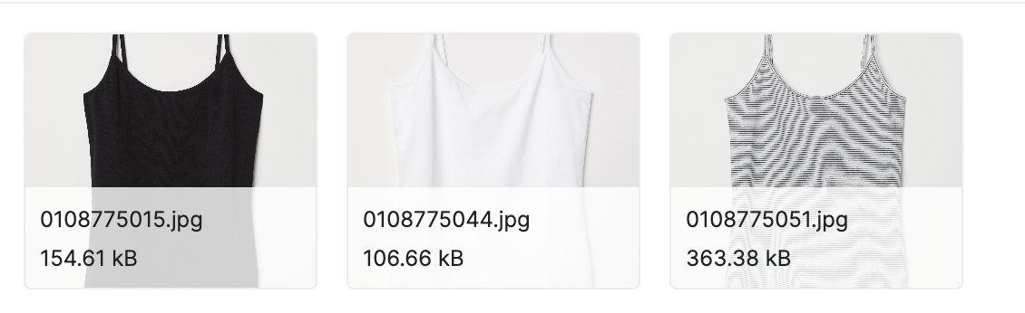
Project Introduction
Dataset: https://www.kaggle.com/competitions/h-and-m-personalized-fashion-recommendations/data

Slide 4
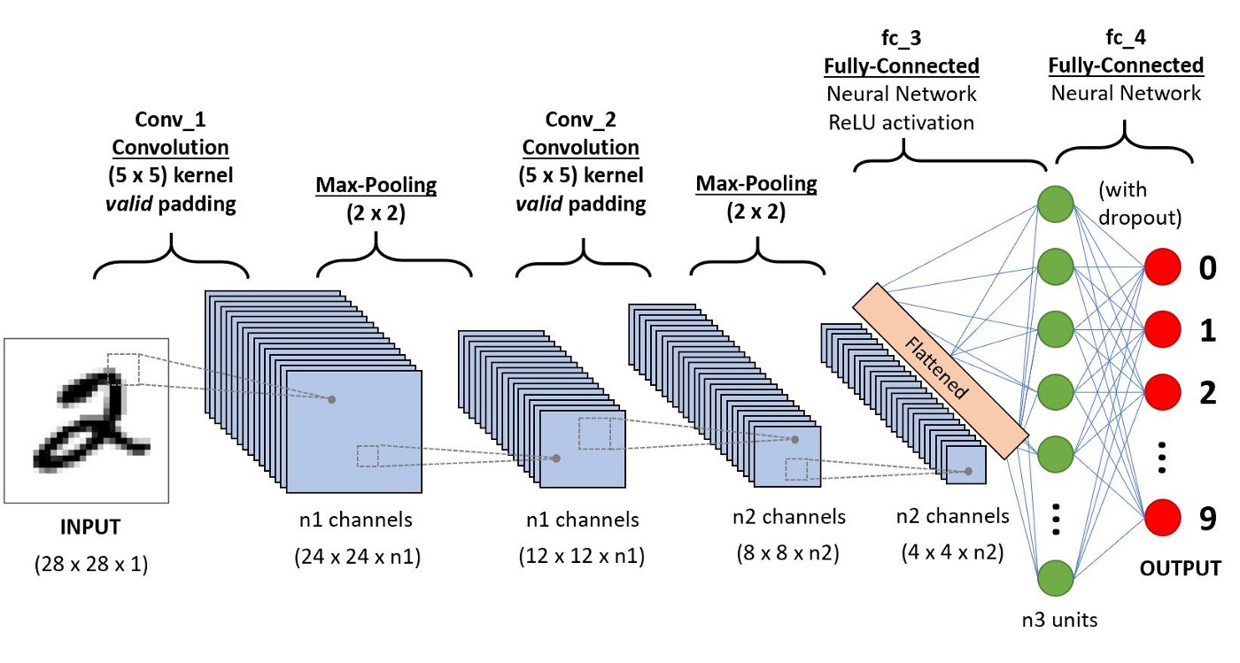
Method
Convolutional neural network(CNN)
Figure from https://towardsdatascience.com/a-comprehensive-guide-to-convolutional-neural-networks-the-eli5-way-3bd2b1164a53

